Slide 1
Defining Moments
2021

Slide 2
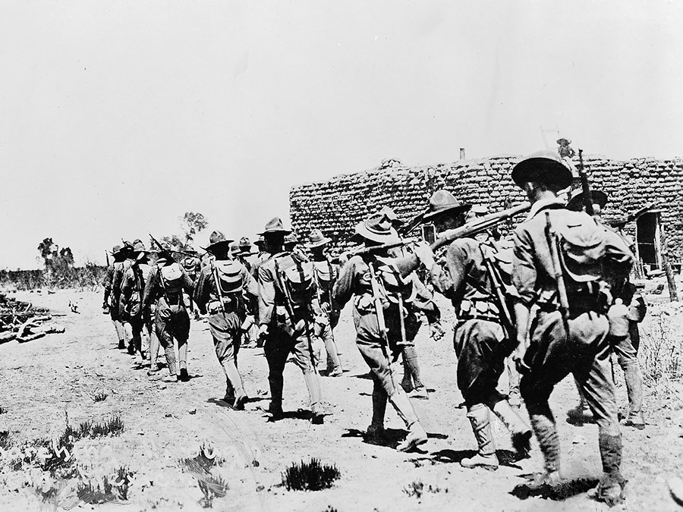
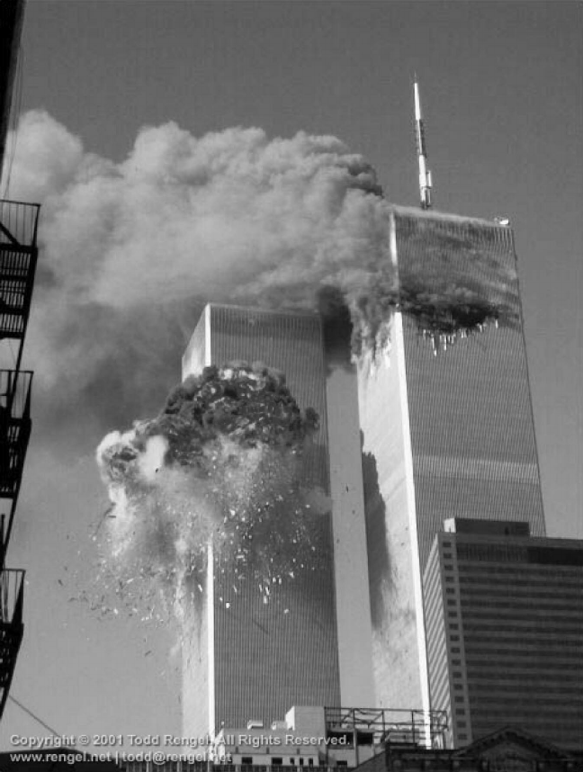
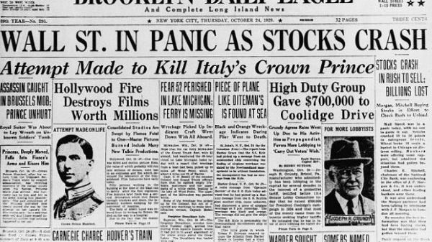
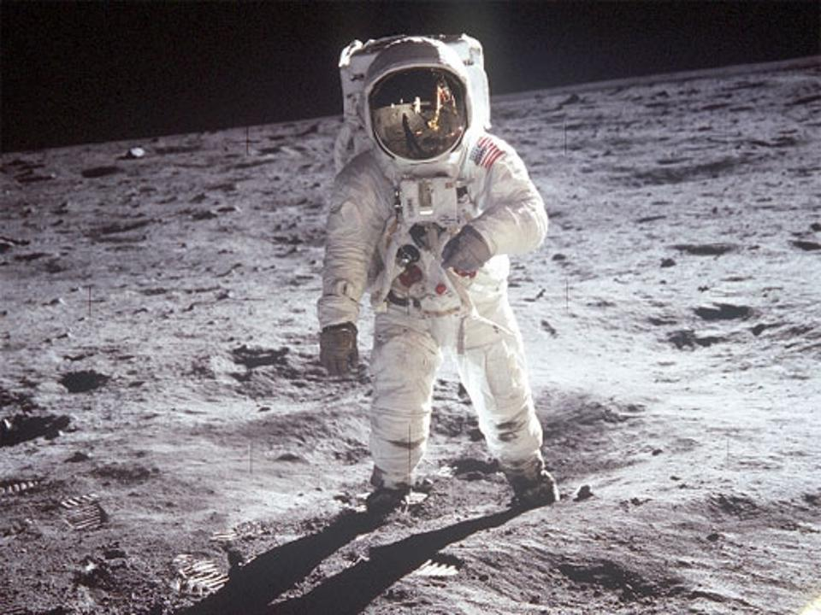

Slide 5
Psalm 100:5
For the Lord is good. His unfailing love continues forever, and his faithfulness continues to each generation.

Slide 6
Jeremiah 32:17
O Sovereign Lord! You made the heavens and earth by your strong hand and powerful arm.
Nothing is too hard for you!

Slide 7
Isaiah 46:9-10
I am God, and there is no other; I am God, and there is none like me. I make known the end from the beginning, from ancient times, what is still to come. I say, ‘My purpose will stand, and I will do all that I please.’

Slide 8
Psalm 27:33
The Lord directs the steps of the godly. He delights in every detail of their lives.

Slide 9
2 Corinthians 5:17
This means that anyone who belongs to Christ has become a new person. The old life is gone; a new life has begun!

Slide 10
Esther 4:14
Who knows if perhaps you were made queen for just such a time as this?

Slide 11
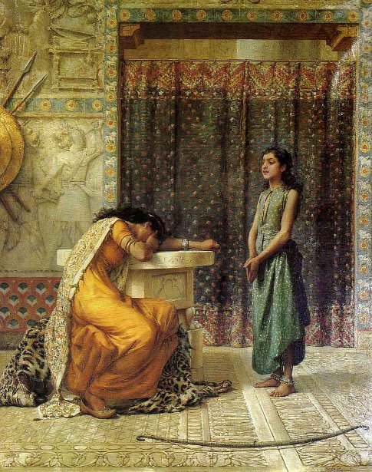
Naaman’s servant girl –
2 Kings 5

Slide 12
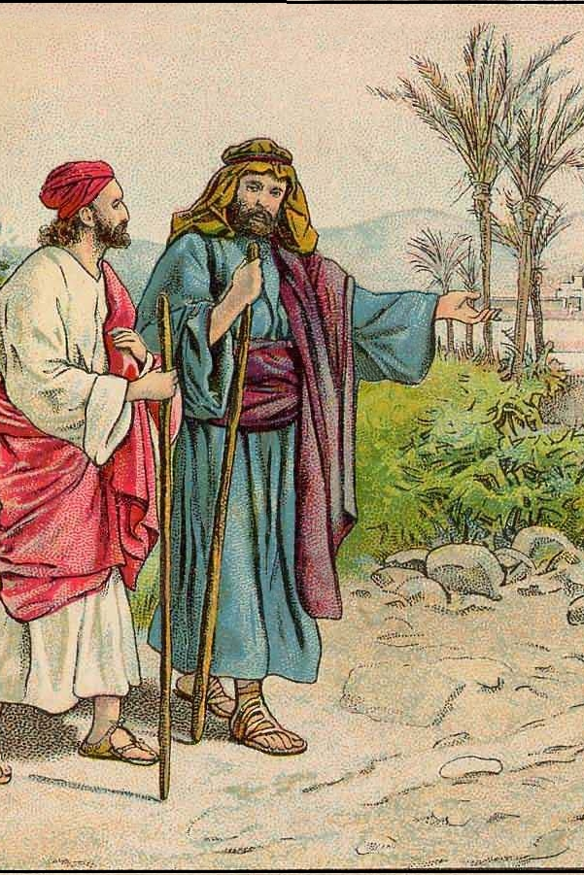
Acts 16:6-7
…because the Holy Spirit had prevented them…
…but again the Spirit of Jesus did not allow them to go there.

Slide 13
Galatians 5:25
Since we are living by the Spirit, let us follow the Spirit’s leading in every part of our lives.

Slide 14
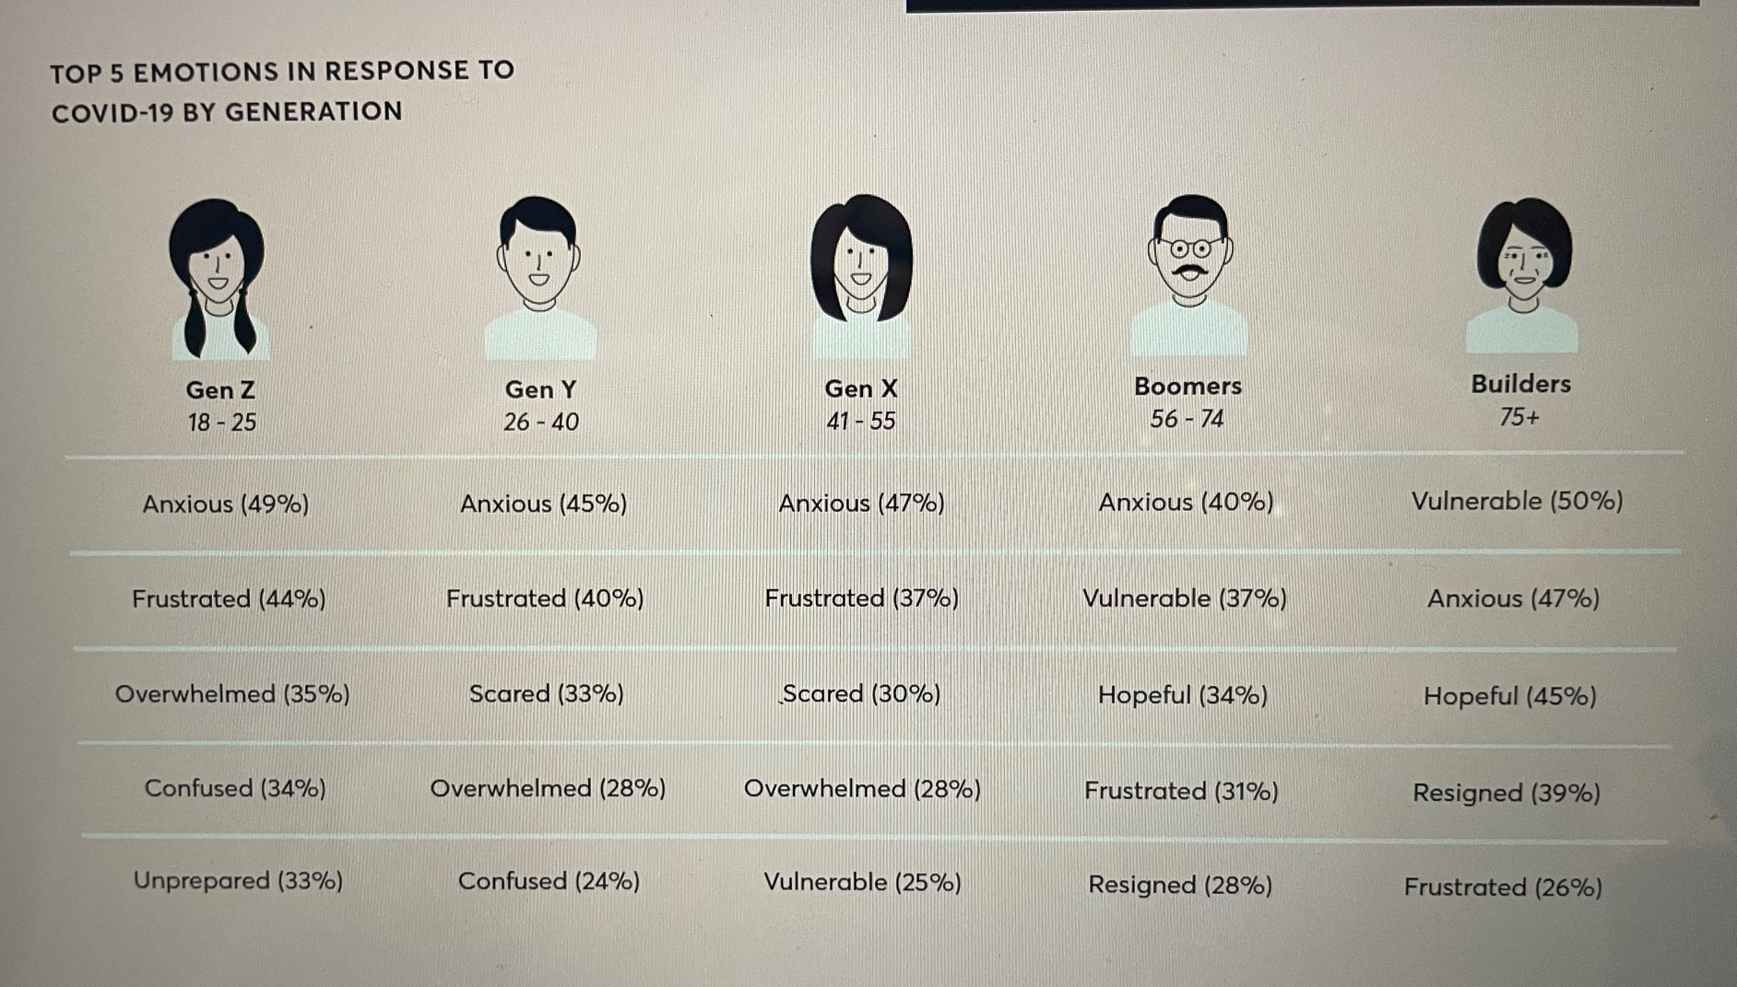

Slide 15
Psalm 78:4…7
We will not hide these truths from our children; we will tell the next generation about the glorious deeds of the Lord…So each generation should set its hope anew on God.

